Slide 1


Smart
Home
Made with 🧡 by Hesham Hany

Slide 2


Table of Content
System Description
Local control system
Remote control system
Auto temperature control

Slide 3
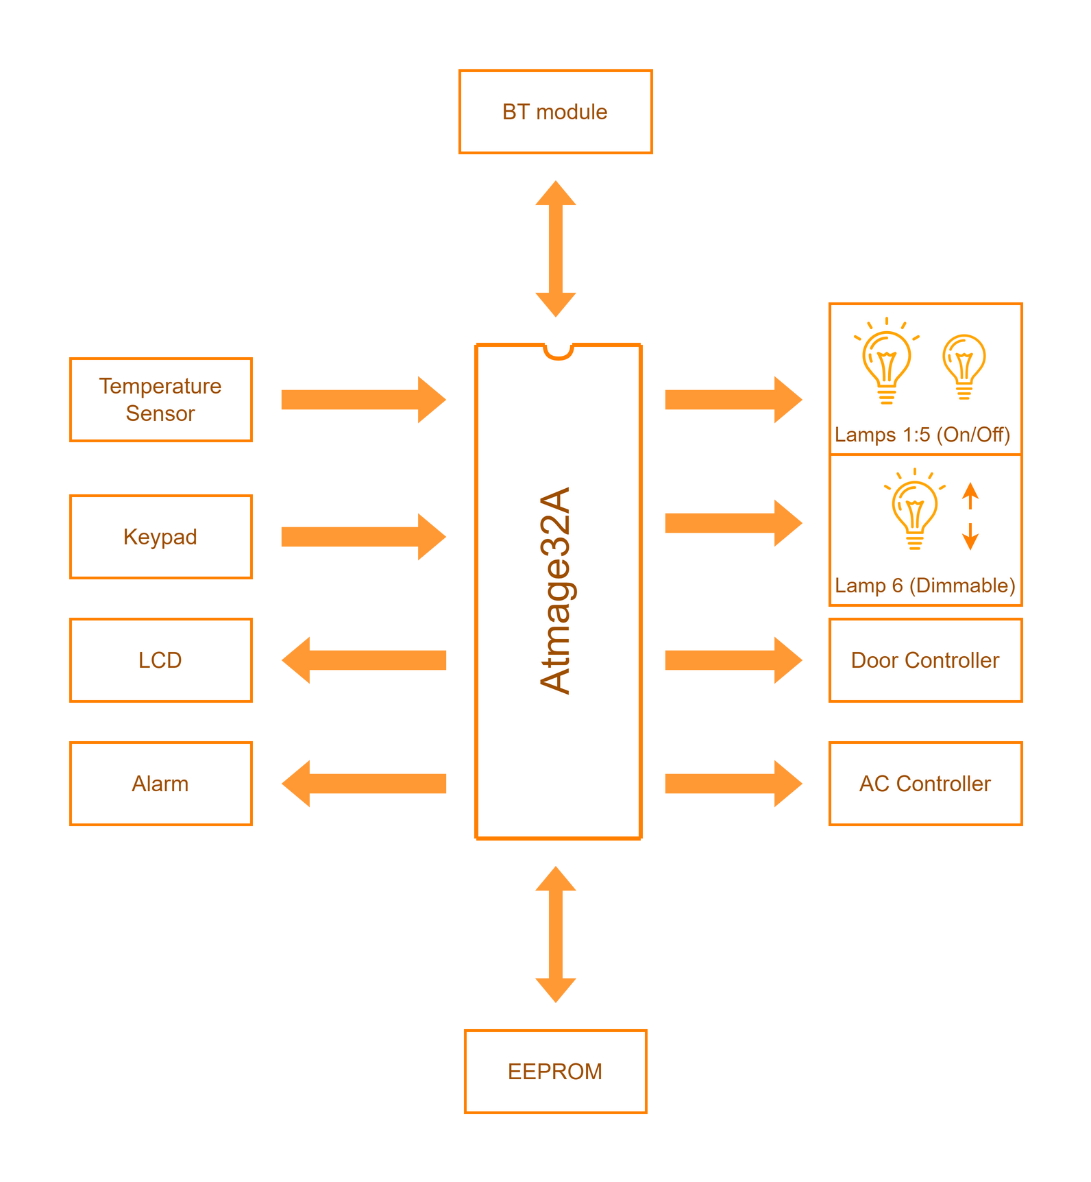
System
Description
System Block diagram:

Slide 4
The system controls the following:
5 lamps(On/Off).
Dimmable lamp.
Door (servo).
AC (auto control based on the room temperature).
The System has two modes:
Remote mode (control via Bluetooth).
Local mode (control via keypad and LCD).

Slide 5
There are two privilege levels for the users:
Admin user:
In addition to all the normal user can do, he can also:
add/delete users on the system.
control the door.
Normal user:
Controls the lamps only.
Both Admin and normal users can log in via local or remote systems, but user management and the door control are only available in the remote system.

Slide 6
User data:
Each user must have:
User name:
used to log in in the remote mode.
The maximum length is 12 characters long.
each user must have a unique user name.
User code:
used to log in in the local mode.
must be a unique 6 digits number. Only digits are allowed as input since it's the only available input in the local mode (via the keypad).
Password:
Needed for authentication
Must consist of digits only. Max length is 10 digits.

Slide 7
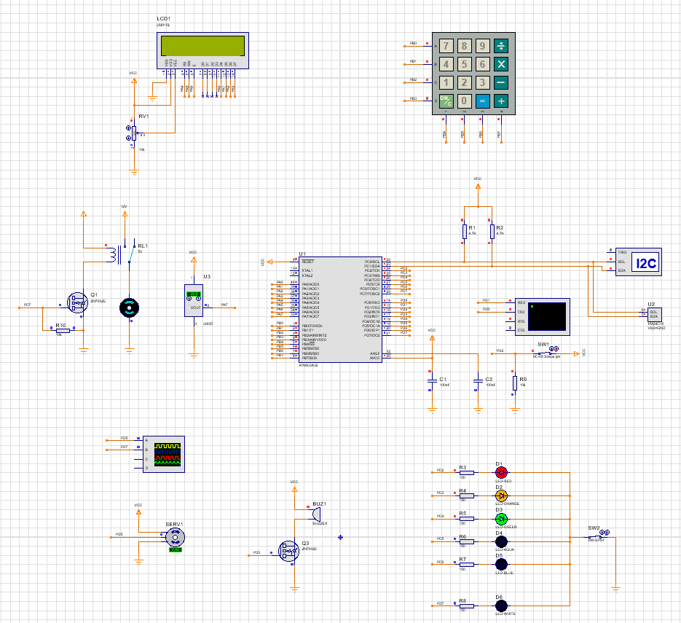
Proteus
Simulation

Slide 8
Local Control
System
The local control system displays the state of the lamps and the AC when the user is logged out. When the user is logged in, the system allows the user to control the lamps by toggling 5 of them and controlling the brightness of the dimmable one.
The user can log in using his user code and password. Failure to enter any one of them three times results in a system halt and setting the alarm. The alarm and the system can only be reset by resetting the microcontroller.
If a remote user is logged in, the control will be paused until the remote user gives control permission.
The system uses the keypad for input and the LCD for output.

Slide 9
Remote Control
System
A log-in prompt is triggered by the interrupt on INT0 pin, which is connected to the Bluetooth module's status pin(goes high when a device is paired). The user can log in using his username and password. Admin users can add/delete users, control the lamps, and the door, and grant control permission to the logged-in local user. Meanwhile, the normal user can only control the lamps.
The user database is stored in the EEPROM and used by both the local and remote systems.

Slide 10
Auto Temperature
Control
The AC turns on and off automatically based on the room temperature. The user has no control over the AC.
The system uses an LM35 temperature sensor connected to the microcontroller's ADC to measure the room temperature. Each 10mV increment in the LM35 output indicates a 1 °C increment in temperature.
The AC is turned on when the room temperature exceeds 28 °C and switched off when the temperature goes below 21 °C.

Slide 11
Thank You
Made with 🧡 by Hesham Hany

